Slide 1
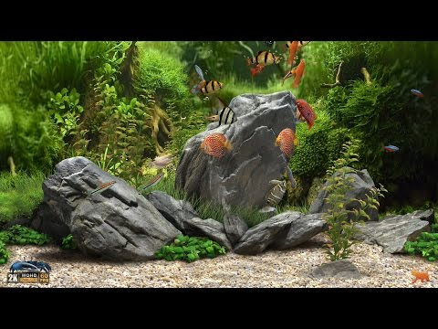
Welcome
to my virtual counseling office! Click on the
objects & explore!

Slide 2
Welcome
to the
Counselor’s Safe Place
Click on the objects & explore!

